Slide 1

COST OF LIVING POWER BI PRESENTATION
BY
DIVYA SOUNDER
BATCH CODE:2021-7265
ENROLLEMENT NO:EBEONO322577974

Slide 2
Power BI
Power BI is a leading BI tool for data analytics, creating data visualization, and preparing ad-hoc reports that gives a multi-perspective view of the dataset. You can handle data from different sources after the cleaning (data cleaning involves steps like, importing data, transforming data to tabular format, splitting up columns, removing unnecessary rows, and unpivoting the region columns) and integration (data integration means aggregating data from various sources and creating a single data model for analysis) process. It allows you to view, visualize and analyze the data. It uses powerful compression algorithms to import data in .PXIB file. It provides multiple software services, over 100 connectors, and a drag-drop feature, increasing ease of use. Dashboards generated are practical and easy to understand. Power BI uses Microsoft systems like Excel, Azure, and SQL, making it an easy win for those already using Microsoft products.

Slide 3
Tableau
Tableau is a popular data visualization and business intelligence tool used for reporting and analyzing vast volumes of data. It helps users create different charts, graphs, maps, dashboards, and stories to visualize and analyze data to help make business decisions. The data generated with Tableau is easy to comprehend for business people of all levels because of its understandable formats. You don’t need to acquire any highly technical skills to create a custom dashboard in Tableau.

Slide 4
DIFFERENCE BETWEEN POWER BI AND TABLEAUE
Power BI | Tableau
Power BI is a low-cost software. The professional version of Power BI costs less than $10 per month per user. | Tableau is more expensive than Power BI. The pro version of Tableau costs more than $35 per month per user.
It performs faster and better when the data volume is limited, but becomes slow while handling bulk data. | It is suitable for handling large volumes of data quickly and provides extensive features for visualizing the data.
The customer support is limited with a free Power BI account. | It has excellent customer support because of its large community forum for discussions.
It supports R language-based visualizations. | It provides full integrated support for R and Python.
It is suitable for small-sized and medium-sized organizations. | It is suitable for medium-sized and large-sized organizations.
With the Embed option in Power BI for its reports, you can easily and securely embed reports in internal web portals. | Embedding reports to a different environment is a challenging task in Tableau.

Slide 5
Power BI offers a query editor (used to edit data files before loading it to Power BI) that helps to do a lot of things easier. | Tableau does not support this feature.
Power BI doesn’t run on Mac, it can only run on Windows since it is a Microsoft’s application. | Tableau can run on Windows and Mac OS.
It is generally use by naïve users and experienced users. | It is generally use by analysts and experienced users for their analytics purposes.
Power BI supports various data sources but has limited access to other databases and servers compared to Tableau. | Tableau Software has access to several data sources and servers.
Power BI has stringent licensing and SaaS infrastructure | Tableau has flexible licensing and n-tier client server architecture..
It is integrated with Microsoft Azure, which helps in analyzing the data and understanding the patterns of the product. | Tableau has built-in machine learning capabilities which makes it suitable for doing ML operations on datasets.

Slide 6


OVERVIEW OF THE CONCEPT :
Cost of living is an economic concept that refers to the general price level for goods and services that the average consumer will purchase for their activities of daily living. It doesn't include all goods and services but a market basket of typical goods and services. It can also be considered as the price of living in a city. When comparing the livability of different cities, knowing the cost of living definition is helpful. Cost of living analysis takes into account the average income of people living in different areas, therefore is a more accurate view when analyzing whether living in one area is cheaper or more expensive than living in another.
Using a simplified example, if a gallon of milk costs $1 in city A and $5 in city B if only the face value is considered, it may seem like living in city A is cheaper. But taking into account of earning power of people, it may be the case that the average household in city A earns $20 monthly while the average household income in city B is $200, which makes city B the cheaper city to work e in.

Slide 7

Cost of Living Analysis
Cost of living analysis is done by comparing the price of a range of goods and services between cities, and the same basket of goods will be weighted based on spending patterns and individual budgets. Different cost of living calculators has different weighting for different items. Generally, housing, groceries, and transport are weighted higher, while apparel will be weighed less. One can also take into account their spending habit and determine a weighting system for themselves. For example, if a household includes young children, one may consider giving a higher weight to education. In contrast, if the household has grown-up kids, then the weighting for education can be decreased or even taken out of the calculation.
In the example above, for an individual to move from city B to city A, they may have to look for higher wages than they originally have in city B in order to maintain their existing quality of life. The online cost of living calculators can be used as a reference.

Slide 8
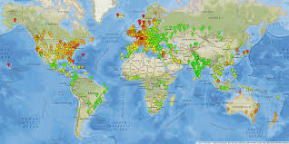
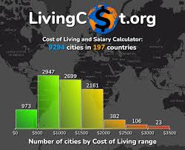
Worldwide cost of living survey
The Economist Intelligence Unit produces a semi-annual (twice yearly) worldwide cost of living survey that compares more than 400 individual prices across 160 products and services. They include food, drink, clothing, household supplies and personal care items, home rents, transport, utility bills, private schools, domestic help and recreational costs.
The survey itself is an internet tool designed to calculate cost-of-living allowances and build compensation packages for corporate executives maintaining a western lifestyle. The survey incorporates easy-to-understand comparative cost of living indices between cities. The survey allows city-to-city comparisons, but for the purpose of this report all cities are compared to a base city of New York City, which has an index set at 100. The survey has been carried out for more than 30 years.
The most recent survey was published in March 2017. Singapore remains the most expensive city in the world for the fourth year running, in a rare occurrence where the entire top five most expensive cities were unchanged from the year prior.^{[4]} Sydney and Melbourne have both cemented their positions as top-ten staples, with Sydney becoming the fifth most expensive, and Melbourne becoming the sixth. Asia is home to more than five most expensive cities in the top twenty but also home to eight cheapest cities of the cheapest ten

Slide 9

Other uses
Stipends or extra pay provided to employees who are being temporarily relocated may also be called cost-of-living adjustments or cost-of-living allowances. Such adjustments are intended to offset changes in welfare due to geographic differences in the cost of living. Such adjustments might more accurately be described as a per diem allowance or tied to a specific item, as with housing allowances. Employees who are being permanently relocated are less likely to receive such allowances, but may receive a base salary adjustment to reflect local market conditions.
A non-taxable cost-of-living allowance is frequently given to members of the U.S. military stationed at overseas bases if the area to which a service member is assigned has a higher cost of living than the average area in the United States. For example, service members stationed in Japan receive a cost of living allowance of between $300 and $700 per month (depending on pay grade, years of service, and number of dependents), in addition to their base pay.

Slide 10
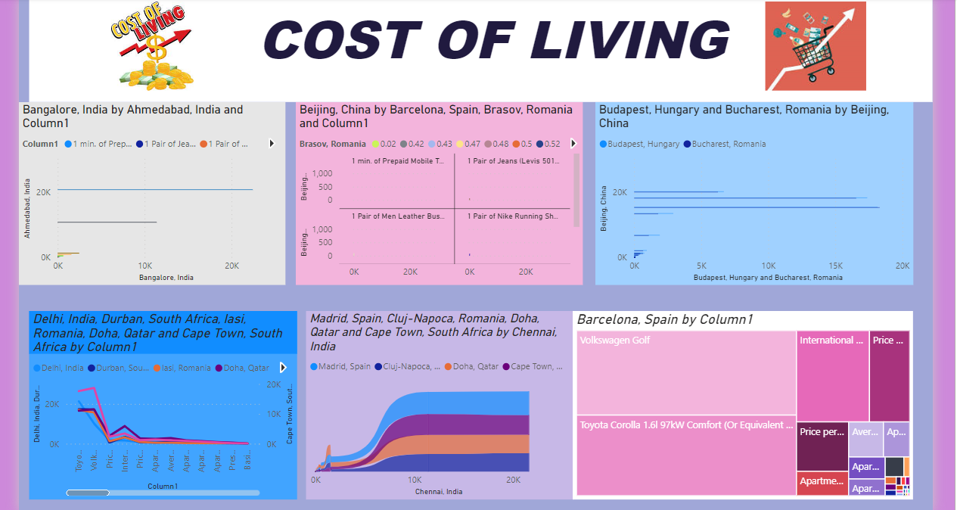
In page one I can use to create a visulisation as stack bar chart, stack column chart ,cluster bar chart, line chart , ribbon chart , tree map

Slide 11
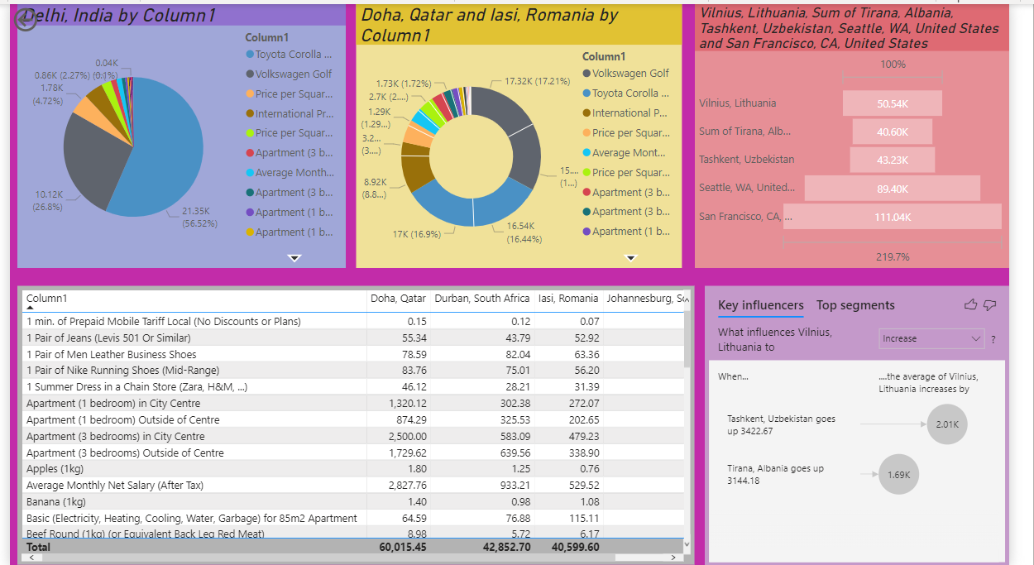
in page two I use pie chart, donut chart, funnel chart, table chart, key influencer

Slide 12
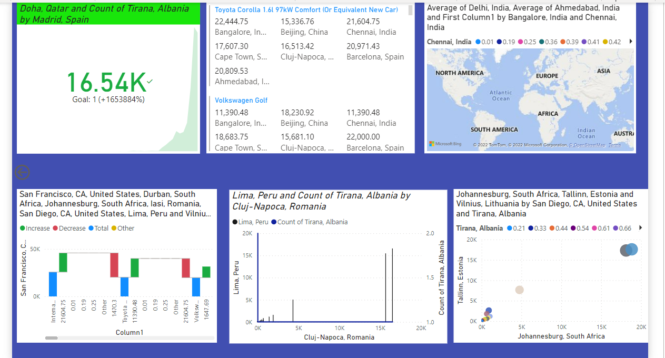
In page three I use KPI, multi row card, filled map, waterfall chart, line and cluster column chart scatter chart

Slide 13
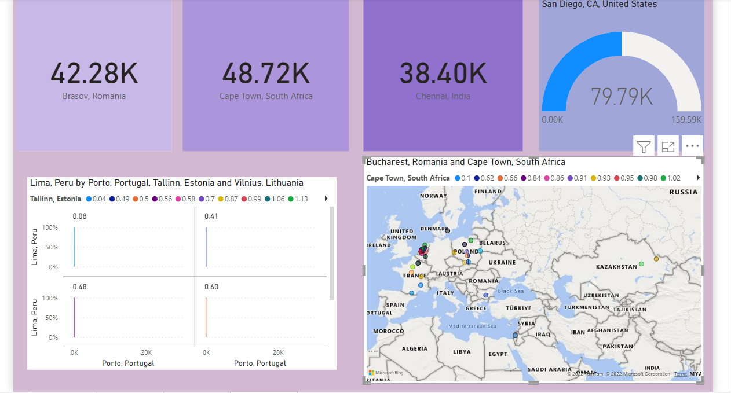
In page four I used card, map, 100% stacked column chart, gauge

Slide 14
Power BI offers a query editor (used to edit data files before loading it to Power BI) that helps to do a lot of things easier. | Tableau does not support this feature.
Power BI doesn’t run on Mac, it can only run on Windows since it is a Microsoft’s application. | Tableau can run on Windows and Mac OS.
It is generally use by naïve users and experienced users. | It is generally use by analysts and experienced users for their analytics purposes.
Power BI supports various data sources but has limited access to other databases and servers compared to Tableau. | Tableau Software has access to several data sources and servers.
Power BI has stringent licensing and SaaS infrastructure | Tableau has flexible licensing and n-tier client server architecture..
It is integrated with Microsoft Azure, which helps in analyzing the data and understanding the patterns of the product. | Tableau has built-in machine learning capabilities which makes it suitable for doing ML operations on datasets.

Slide 15


THANK YOU
CONTACT NUMBER:9176743513
MAIL
ADDRESS:divyasampath0627@gmail.com

